Slide 1


Belief-Rewards to Learn Radar Scheduling Policies
Amos Hebb
Raviraj S Adve
Zhen Qu
Zhen Ding

Slide 2
Forecast
A radar scheduler’s goal is to sequence beams to best understand its environment.
Belief-dependent rewards can be used to develop both search and tracking policies.

Slide 3
Outline
Introduction
Background
System Model
Implementation
POMDP
Solvers
Numerical Results
Summary

Slide 4
Motivation
Beam-agile radars can select beams in any order
Goal is to best understand environment
Existing approaches:
Treat Search and Track as independent functions
Independently reduce resource usage
Meet operator or system designer “requirement”
Collaborate by a scheduler, dropping or shifting tasks
Fragile performance in changing environments

Slide 5
Problem Statement
Beam-Agile sensor is controlled by an agent
Agent select’s beam direction
Goal: understand the environment
Formulate Problem as a POMDP
Within framework:
belief: set of particle filters
solver: with belief-reality distance oracle, make policy
policy: use belief to select next beam

Slide 6
System Model: POMDP
S state space A action space T transition R reward space
O observation space Z observation probability ρ belief reward u belief updater

Slide 7
System Model: Radar
Like closed-loop system in BWW^{[1]}
Surveillance region polar coordinates from – π to π
Sensor at origin
Fixed beam width: π/15 rad
Range: 20km to 200km
p_{detection}: SNR such that p_{detection} = 0.5 at 100km
dwell time: 0.2s
targets piecewise-constant velocity from 0 to 700 m/s
[1] M. Byrne, K. White and J. Williams, "Scheduling multifunction radar for search and tracking," 2015 18th ISIF (FUSION), pp. 945-952.

Slide 8
Implementation: POMDP
State Space, [(x,y,x',y'),…]
Action Space, [0,1)
Transition Function, apply x' to x
Observation Function
Select visible, in range, targets
Filter targets by comparing P_{d} to random number
Convert to theta and radial velocity
Add gaussian noise
Include target id

Slide 9
Implementation: BMDP
Updater
Set of particle filters
Observations initialize and update
BMDP
Solve like MDP
Belief state – result of applying updater
Particle Filters as basic trackers
Vector of action recency as history
ρ(s, b) can be defined as r(s, a)

Slide 10
Implementation: Baseline Solvers
Random Solver: Emits random policy
Sequential Solver: Emits beam sweep policy
Single Sweep Solver: Rotates once then stops
Highest Variance Solver: Emits heuristic policy

Slide 11
Implementation: Learned Solver
Belief-BetaZero Solver:
Progressive widening for continuous state, action
BetaZero based on AlphaZero for POMDPs
Modified BetaZero solver for ρPOMDP with no r(s,a).
Offline component, collects data, trains prediction model, iteratively improves prediction model.
Emits a policy which uses learned estimator to execute online Monte Carlo Tree Search

Slide 12
Results
Expected Belief-Reward

Slide 13
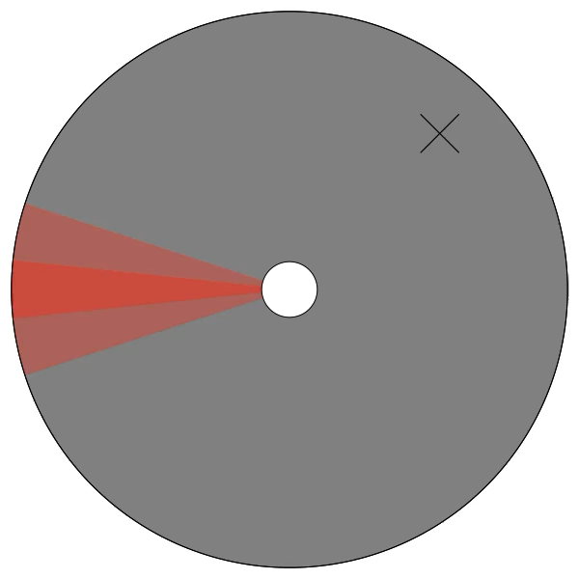
Results
Understanding Belief-Reward
Single Sweep Policy – Single Target – Single Detection

Slide 14
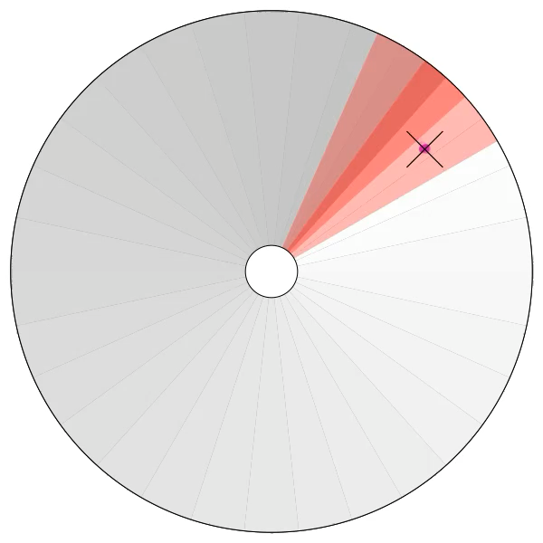
Results
Understanding Belief-Reward
Sequential Policy - Single Target

Slide 15
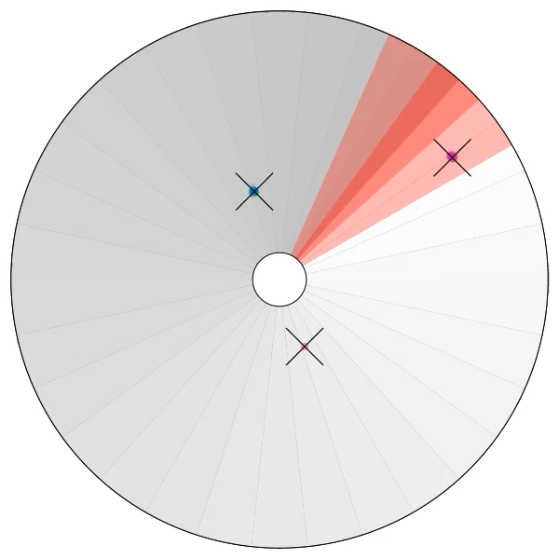
Results
Understanding Belief-Reward
Sequential Policy - Many Targets

Slide 16
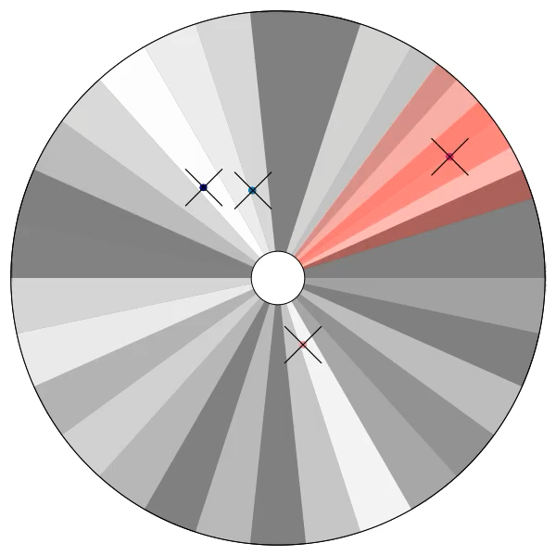
Results
Understanding Belief-Reward
Heuristic Policy - Many Targets

Slide 17
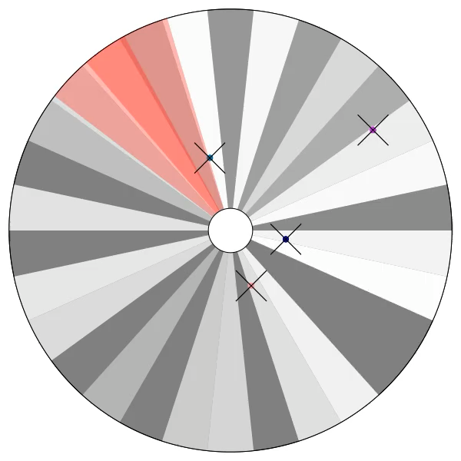
Results
Understanding Belief-Reward
Learned Policy

Slide 18
Results
1000 runs, 1-20 targets

Slide 19
Results
Learned Policy Makes Non-Highest Variance Decision

Slide 20
Summary
Training a policy solely focused on enhancing a belief model shows improvements over a random selector.
Policies are decoupled from the environment and belief dimensionality.

Slide 21
Questions?
a.hebb@mail.utoronto.ca

